Slide 1
24
Measuring the Cost of Living

Slide 2

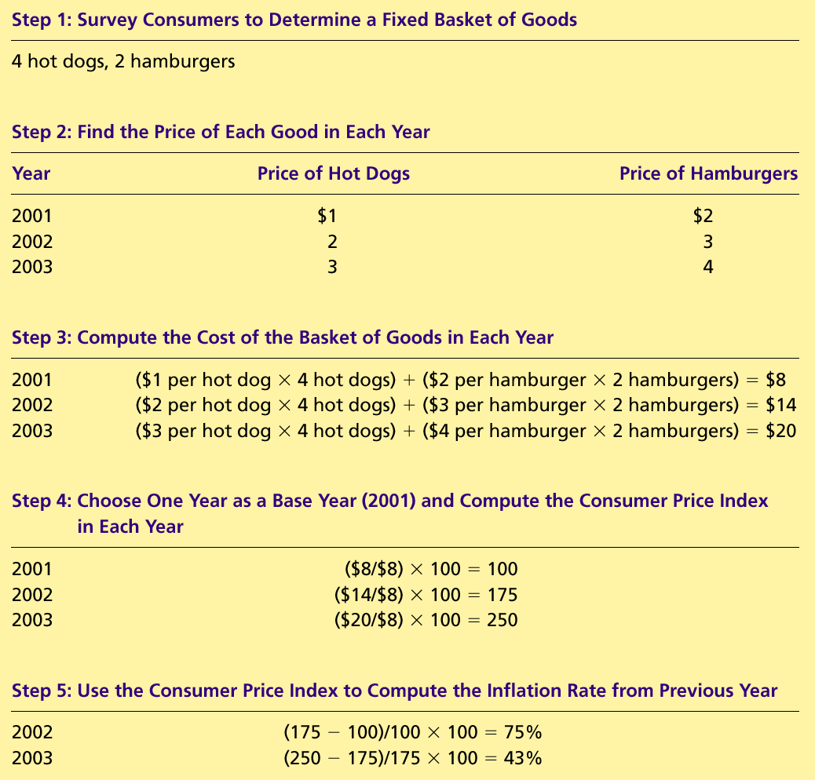
Table 1 Calculating the Consumer Price Index and the Inflation Rate: An Example
Copyright©2004 South-Western

Slide 3
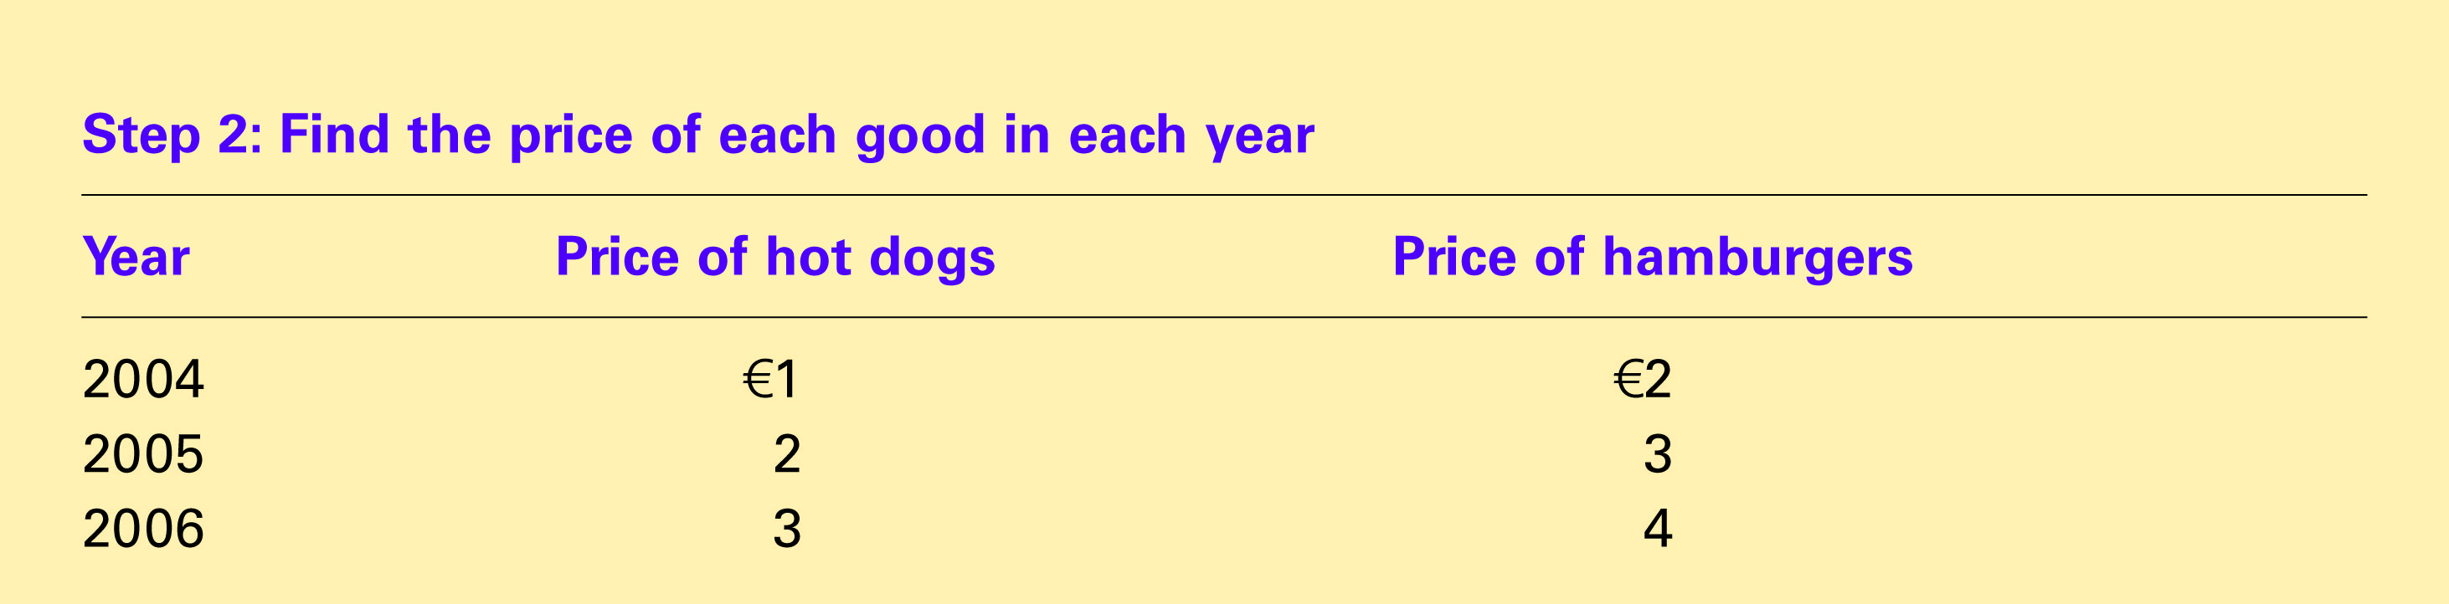
Table 1 Calculating the Consumer Price Index and the Inflation Rate: An Example
Copyright©2004 South-Western

Slide 4
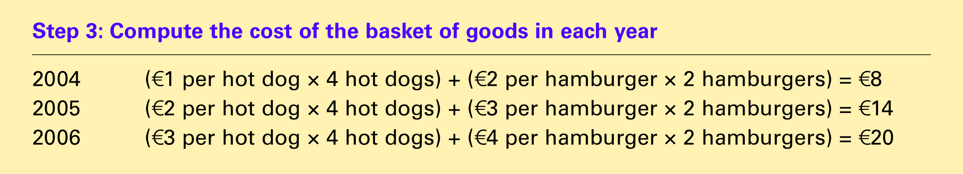
Table 1 Calculating the Consumer Price Index and the Inflation Rate: An Example
Copyright©2004 South-Western

Slide 5
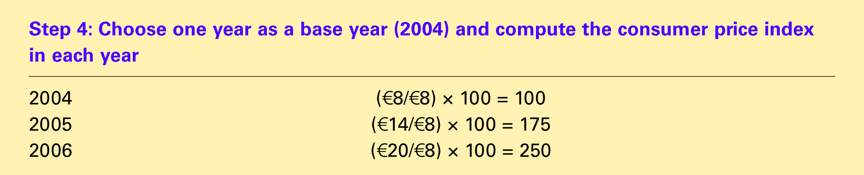
Table 1 Calculating the Consumer Price Index and the Inflation Rate: An Example
Copyright©2004 South-Western

Slide 6
Table 1 Calculating the Consumer Price Index and the Inflation Rate: An Example
Copyright©2004 South-Western

Slide 7

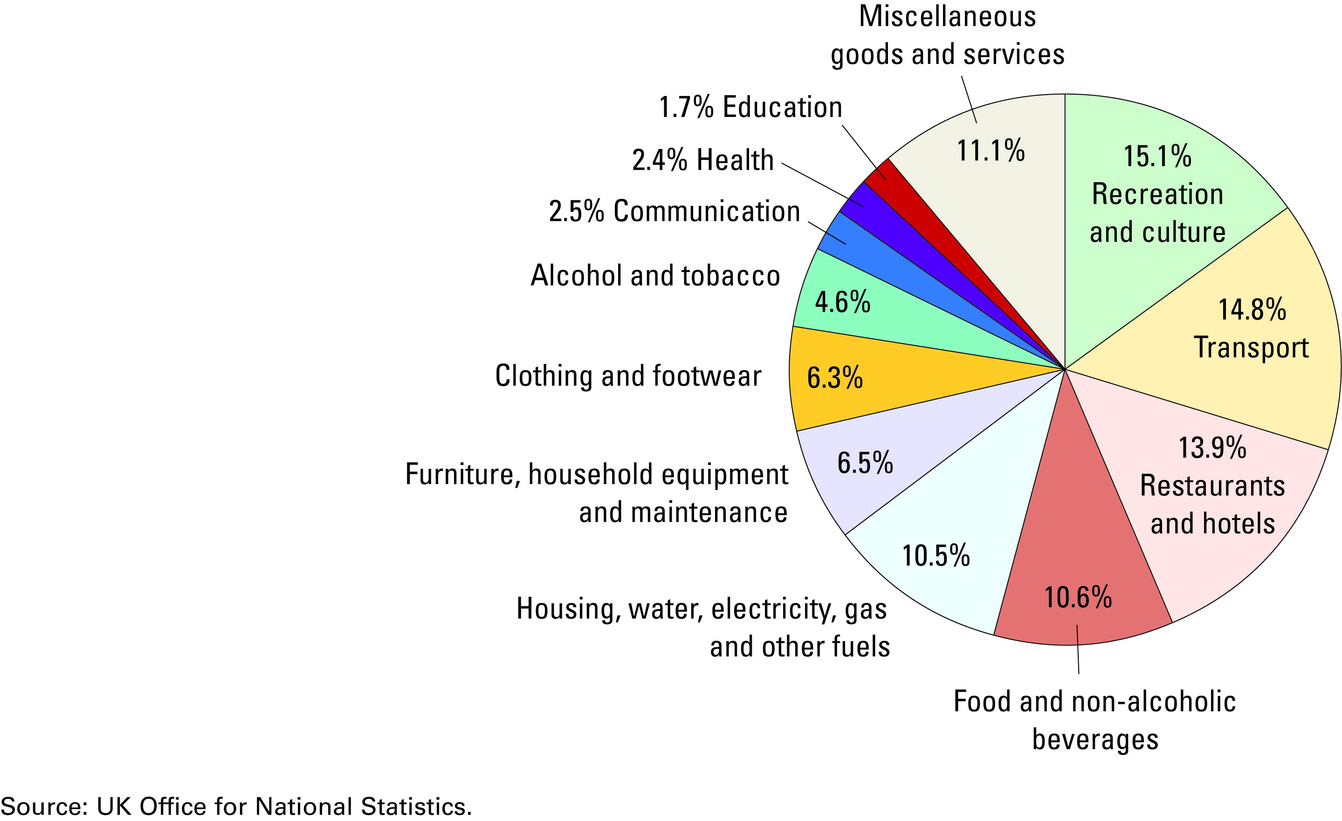
FYI: The Typical Basket of Goods and Services
Copyright©2004 South-Western

Slide 8
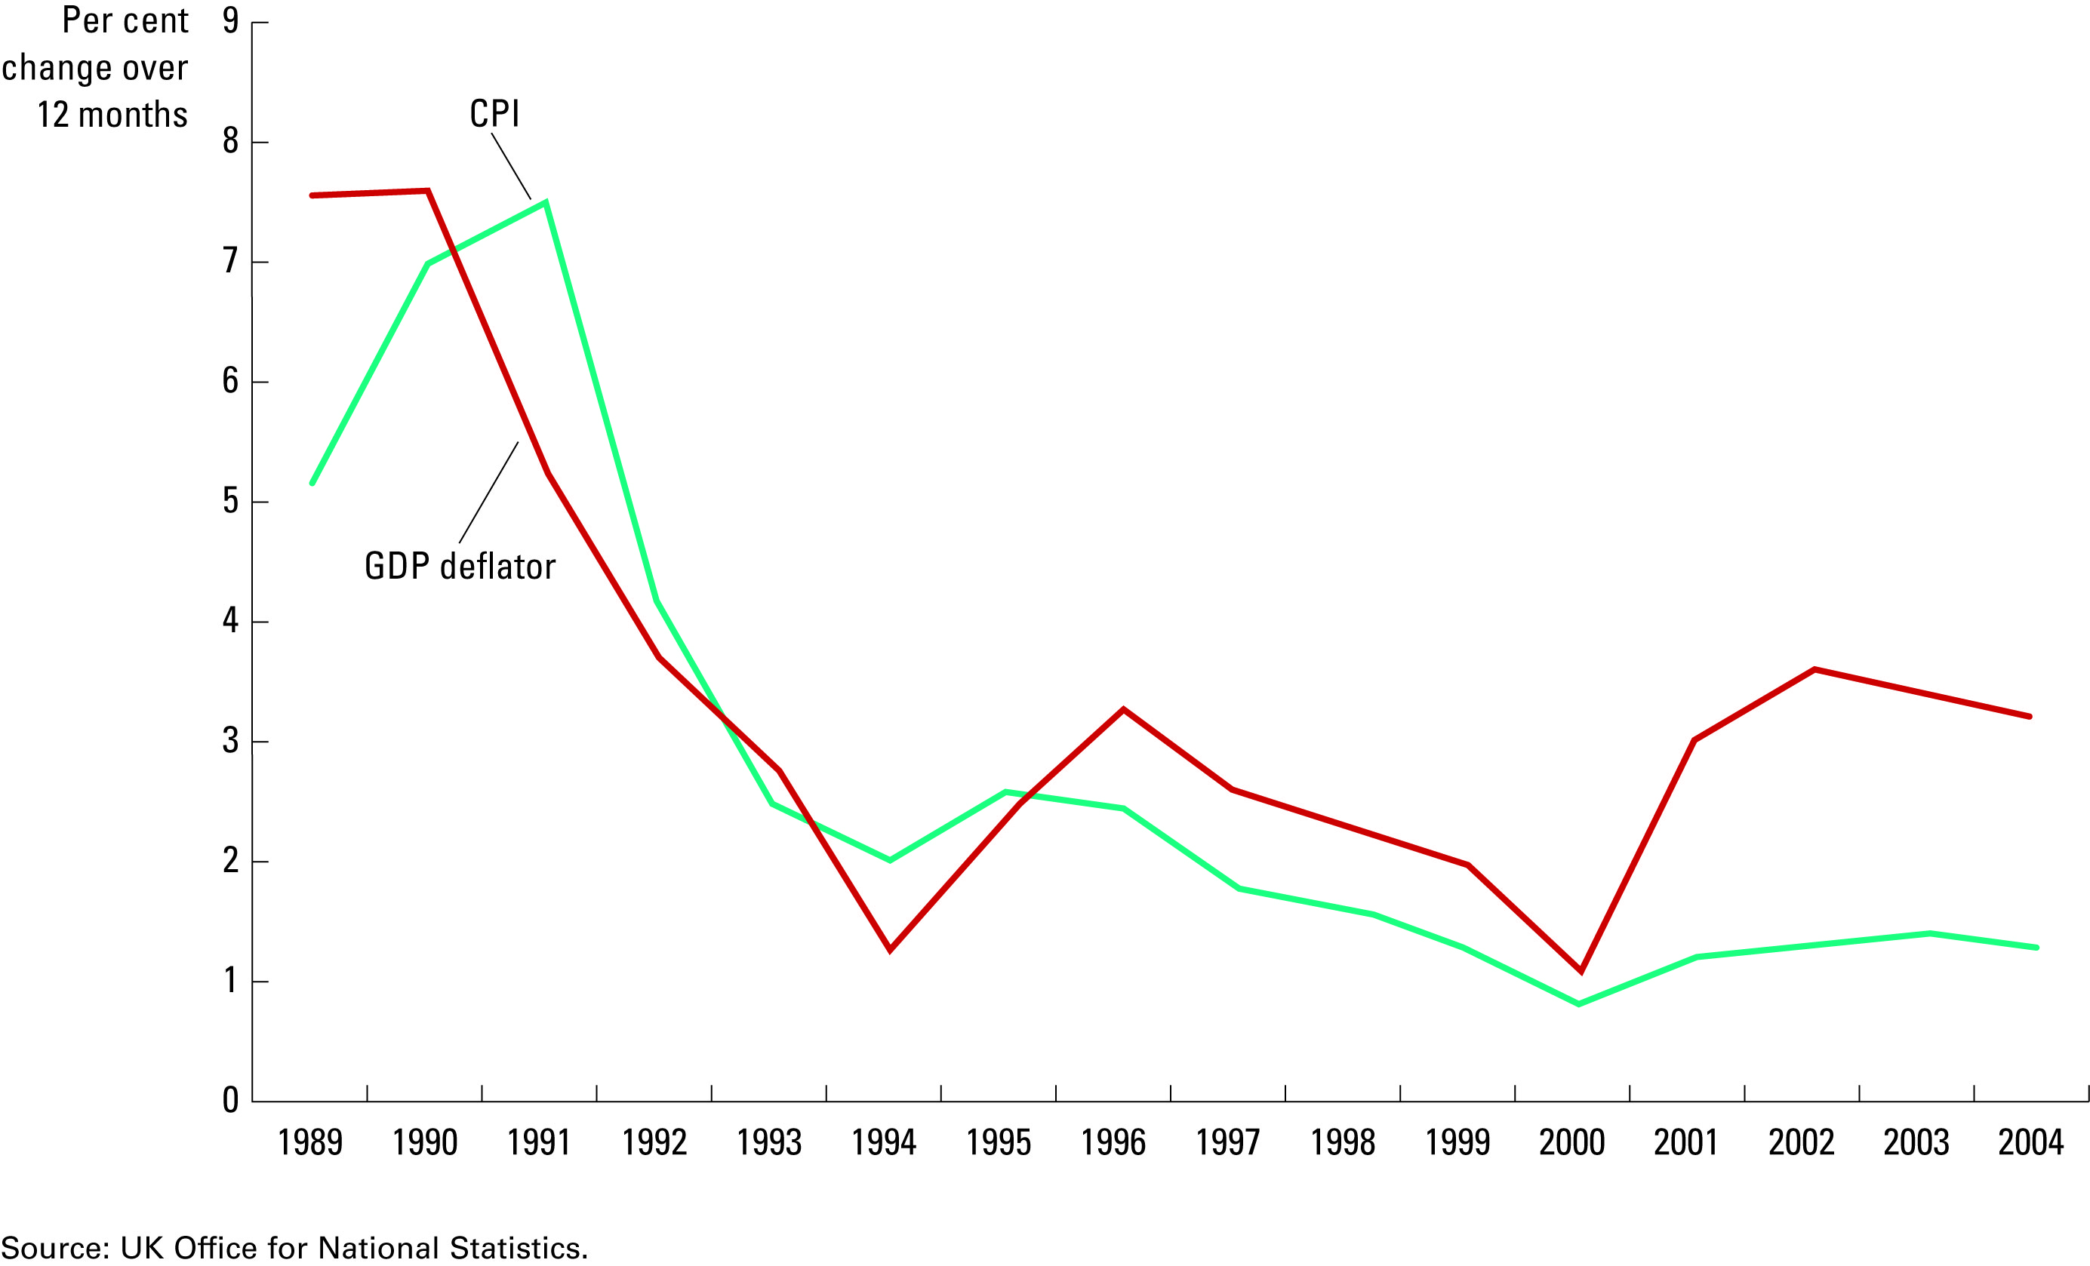
Figure 2 Two Measures of Inflation
Copyright©2004 South-Western

Slide 9
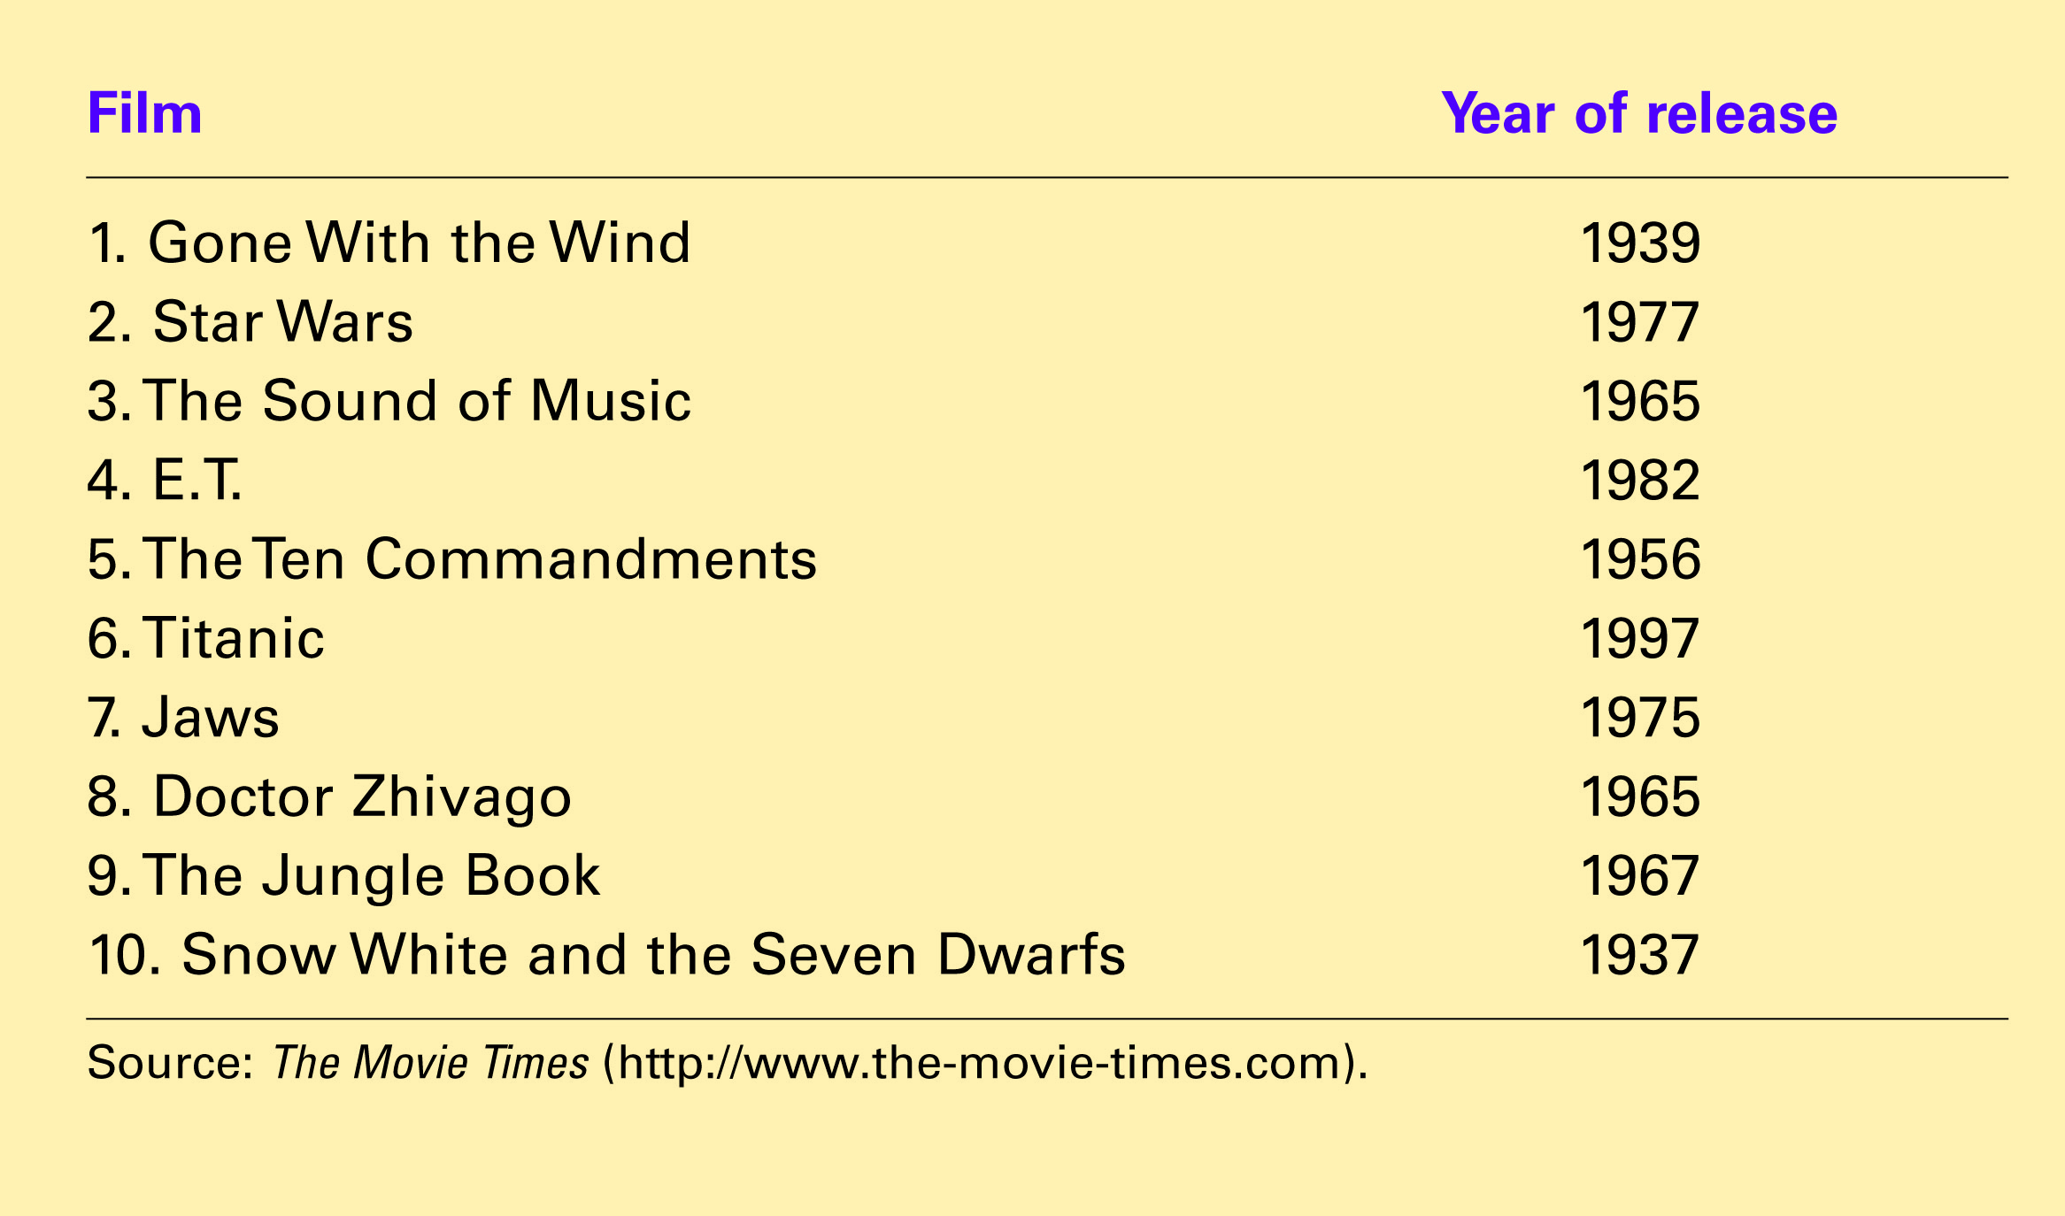
Table 2 The Most Popular Movies of All Times, Inflation Adjusted
Copyright©2004 South-Western

Slide 10
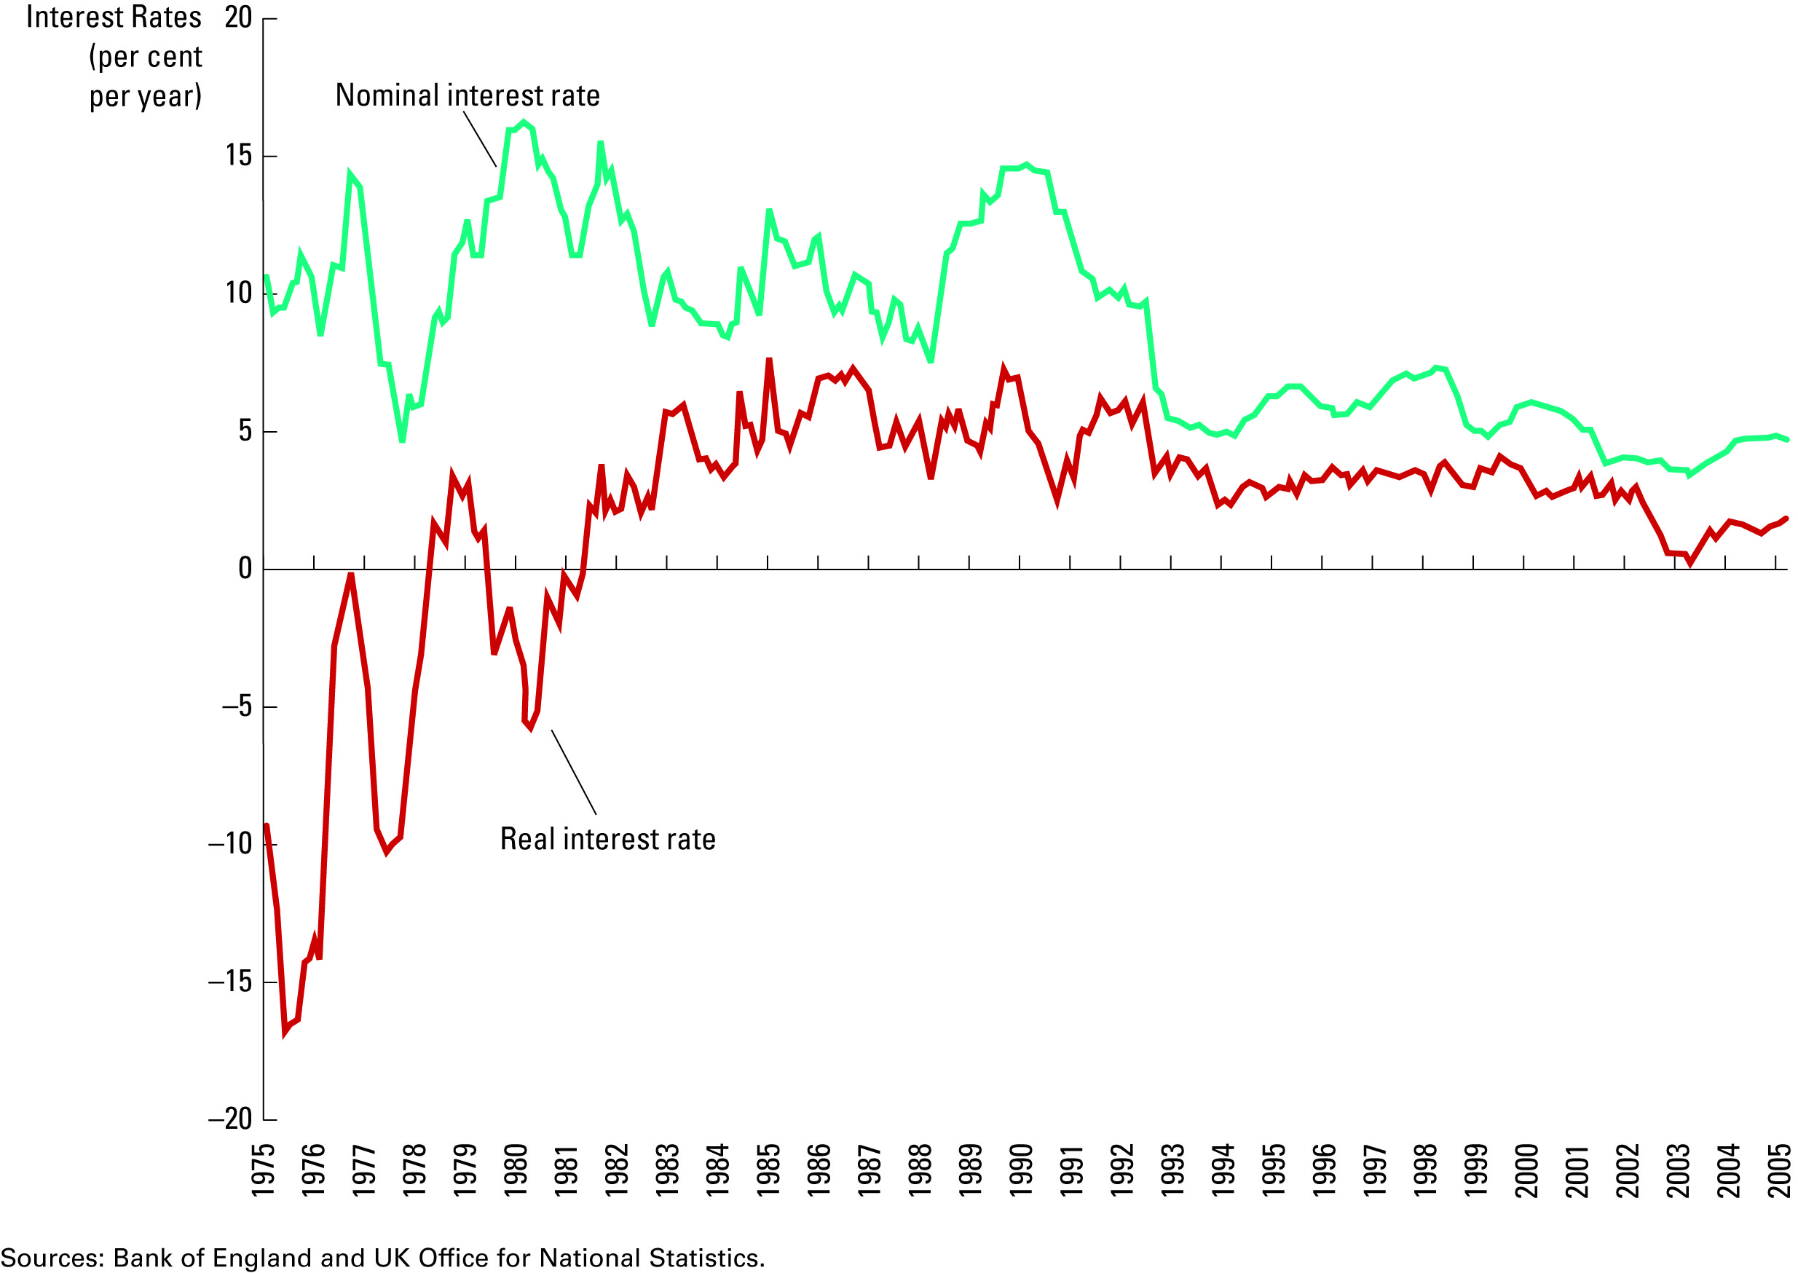
Figure 3 Real and Nominal Interest Rates
Copyright©2004 South-Western

